Slide 1





19th XBRL International Conference – June 25, 2009
Computer-Assisted Tools for Auditing XBRL-Related Documents
University of Waterloo
Efrim Boritz
Iowa State University
Won Gyun No

Slide 2


AGENDA
Introduction
Financial reporting using XBRL and assurance
Assurance on XBRL-Related Documents and audit tools
  An assurance framework for XBRL-Related Documents
  Computer-assisted audit tools
XBRL audit case and preliminary evaluation
Concluding remarks

Slide 3













INTRODUCTION
Limited liability provisions for XBRL
Increased XBRL implementation for regulatory filings
Quality of XBRL-tagged information
Limited guidance for and experience with XBRL
U.K., Canada, Japan, Korea, China, etc.
SEC mandates use of interactive data for public company and mutual fund reporting (Dec. 17, 2008).
  No assurance on XBRL-Related Documents
  Luis Aguilar (SEC Commissioner)
  “Limiting liability puts investors at greater risk for misleading disclosures and for suffering losses.”
  The tagged data will not be subject to antifraud claims by investors even if the information is inaccurate, assuming the mistake was made with good faith.
Elliott (2002), Pinsker (2003), Farewell & Pinsker (2005), Brian, Okesson, & Watson (2006), and Boritz & No (2004, 2008)

Slide 4
INTRODUCTION
Limited liability provisions for XBRL
Increased XBRL implementation for regulatory filings
Quality of XBRL-tagged information
Limited guidance for and experience with XBRL
U.K., Canada, Japan, Korea, China, etc.
SEC mandates use of interactive data for public company and mutual fund reporting (Dec. 17, 2008).
  No assurance on XBRL-Related Documents
  Luis Aguilar (SEC Commissioner)
  “Limiting liability puts investors at greater risk for misleading disclosures and for suffering losses.”
  The tagged data will not be subject to antifraud claims by investors even if the information is inaccurate, assuming the mistake was made with good faith.
Elliott (2002), Pinsker (2003), Farewell & Pinsker (2005), Brian, Okesson, & Watson (2006), and Boritz & No (2004, 2008)
Identify a set of specific audit objectives and related audit tasks for assurance engagements on XBRL-Related Documents.
Discuss how a prototype XBRL auditing tool can be used to accomplish the audit tasks to achieve audit objectives.

Slide 5
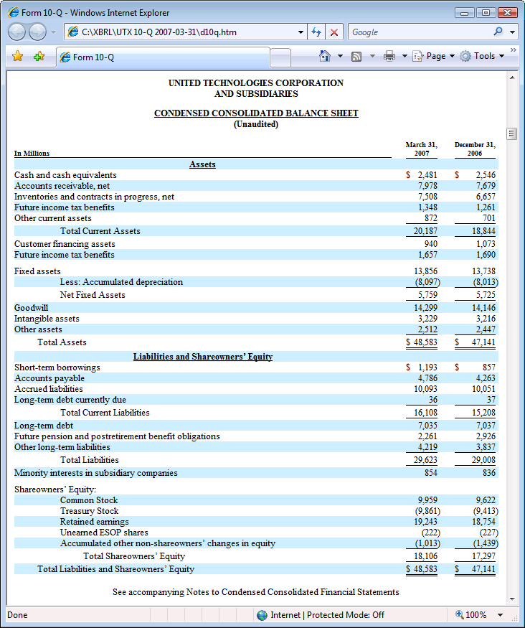
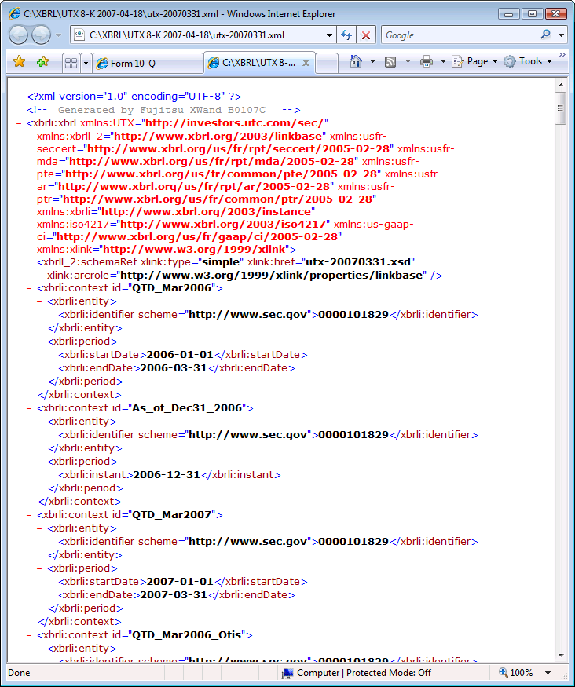
ASSURANCE ON
XBRL-RELATED DOCUMENT
=
≠
≡
Do the data contained in the XBRL instance document completely, accurately and consistently reflect the financial facts in the corresponding original financial statements?

Slide 6









AN ASSURANCE FRAMEWORK
FOR XBRL-RELATED DOCUMENTS
  AICPA (2003)
  Attest Engagements: Attest Engagements Interpretations of Section 101, Interpretation No 5. Attest Engagements on Financial Information Included in XBRL Instance Documents.
  PCAOB (2005)
  Staff Q&A Regarding XBRL Financial Reporting
  Assurance Working Group of XBRL International (AWG) (2006)
  Interactive Data: The Impact on Assurance, New Challenges for The Audit Profession
  ACIPA (2009)
  Statement of Position (SOP) 09-1

Slide 7
AN ASSURANCE FRAMEWORK
FOR XBRL-RELATED DOCUMENTS
  Characteristics of auditors
  An auditor should not only be independent but also have sufficient knowledge to evaluate the risk of misstatement in the XBRL-Related Documents.
  Internal control over the creation of XBRL-Related Documents
  To determine whether the controls over the creation of the XBRL-Related Document are operating effectively (and efficiently)
  Compliance
  To determine whether the XBRL-Related Documents are created in accordance with the relevant XBRL specifications and regulatory requirements
  Suitability
  To determine whether appropriate elements are used to tag the underlying business facts in the official filing and the extension taxonomies are necessary.
  AICPA (2003)
  Attest Engagements: Attest Engagements Interpretations of Section 101, Interpretation No 5. Attest Engagements on Financial Information Included in XBRL Instance Documents.
  PCAOB (2005)
  Staff Q&A Regarding XBRL Financial Reporting
  Assurance Working Group of XBRL International (AWG) (2006)
  Interactive Data: The Impact on Assurance, New Challenges for The Audit Profession
  ACIPA (2009)
  Statement of Position (SOP) 09-1

Slide 8
AN ASSURANCE FRAMEWORK
FOR XBRL-RELATED DOCUMENTS
  Accuracy
  To determine whether the XBRL-Related Documents accurately reflect, in all material respects, all business facts presented in the source documents or files (e.g., a regulatory filing)
  Completeness
  To determine whether all business facts in the source documents or files are completed tagged in the XBRL-Related Documents
  Occurrence
  To determine whether XBRL-Related Documents contain information that is not in the source documents or files
  Consistency
  To determine whether the XBRL-Related Documents are prepared in a manner consistent with prior periods
  AICPA (2003)
  Attest Engagements: Attest Engagements Interpretations of Section 101, Interpretation No 5. Attest Engagements on Financial Information Included in XBRL Instance Documents.
  PCAOB (2005)
  Staff Q&A Regarding XBRL Financial Reporting
  Assurance Working Group of XBRL International (AWG) (2006)
  Interactive Data: The Impact on Assurance, New Challenges for The Audit Profession
  ACIPA (2009)
  Statement of Position (SOP) 09-1

Slide 9
AUDIT OBJECTIVES
AND RELATED TASKS
Objectives | Audit Tasks
Internal Control | The auditor should access whether appropriate controls exist for the mapping of the financial statements to the taxonomies, the creation of the extension taxonomies, and tagging of the financial statements to create the instance documents.
Compliance | The auditor should evaluate whether the XBRL instance document complies with the appropriate XBRL specification and appropriate XBRL taxonomies. The auditor should test whether the XBRL instance document complies with FRIS. The auditor should test whether the extension taxonomies comply with FRTA. The auditor should evaluate whether any company extensions of the taxonomy are consistent with applicable legislative or regulatory requirements and XBRL specifications. The auditor should determine the quality or appropriateness of the taxonomy, or taxonomies in terms of authority, history, and purpose. The auditor should determine whether the XBRL-Related Documents (and the related taxonomy documents, as necessary) conform to the applicable legislative or regulatory requirements.
Suitability | The auditor should determine that the taxonomy selected is the most recent acknowledged or approved one, that the extensions are appropriate, and that the taxonomy, as extended, represents suitable and available criteria. The auditor should assess that suitable elements are used to tag the underlying financial facts. The auditor should verify that the extension taxonomies have only elements that are not in the standard XBRL taxonomies.
Accuracy | The auditor should test whether the data elements (i.e., text, line item names, associated values, unit, decimals, dates, and other labels) in the XBRL-Related Documents reflect the same information as the corresponding source document (i.e., the HTML or PDF version). The auditor should evaluate whether data elements in the XBRL-Related Documents are matched with appropriate tags in accordance with the applicable taxonomy. The auditor should compare the rendered XBRL-Related Documents to the corresponding information in the official filing. The auditor should verify that the data elements in the corresponding official filing have not been changed, deleted, or summarized in the XBRL-Related Documents. The auditor should evaluate whether the XBRL instance document not only has required information (e.g., identifier, unit, period, language, etc.), but also appropriately tagged financial facts as required by rules (e.g., each complete footnote tagged as a single block of text required by SEC rules).
Completeness | The auditor should assess that all business facts in the corresponding official filing are completely tagged in the XBRL-Related Documents. The auditor should assess whether the XBRL-Related Documents contain all applicable information that is required by regulators and government agencies.
Occurrence | The auditor should assess that information not in the official filing is not in the XBRL-Related Documents.
Consistency | The auditor should determine whether the XBRL-Related Documents are created based on the same official and extension taxonomies, unless otherwise indicated, across reporting periods. The auditor should test whether the same rules are applied to create context information for the XBRL-Related Documents of different reporting periods (e.g., the same identifier and scheme are used in all contexts). The auditor should assess whether there exists reliable, efficient version control and stable access to the extension taxonomies.

Slide 10
THREE USEFUL FUNCTIONS
FOR XBRL AUDIT
  Validation of XBRL instance documents and company taxonomy extensions
  To check whether an instance document and company extension taxonomies comply with the relevant XBRL specifications.
  Essential for determining whether an XBRL documents complies with XBRL specifications and recommended practices.
  Mapping/Tracing
  To map/trace elements in the XBRL instance document to the financial facts in the original financial statements.
  Most useful function for assessing whether the XBRL-Related Documents are a complete and accurate reflection of the business facts in the official financial statements
  The usefulness of a mapping tool declines as the chart of accounts becomes less standardized and as the use of taxonomy extensions increases.
  Rendering XBRL instance documents
  XBRL was developed for machine-to-machine information transfer, not designed for ease of use by people.
  Most people would find it difficult to review or audit XBRL code.
  To render XBRL instance documents to enable visual review and detailed checking of XBRL instance documents to original financial statements and vice versa.
  SEC’s Interactive Financial Report Viewer
    Does not portray the instance document exactly as it is represented by the presentation linkbase (i.e., it is not the ‘true’ representation of the instance document based on the presentation linkbase.)
    May not be an accurate reflection of the underlying XBRL instance document and may not reveal coding errors and inconsistencies.

Slide 11
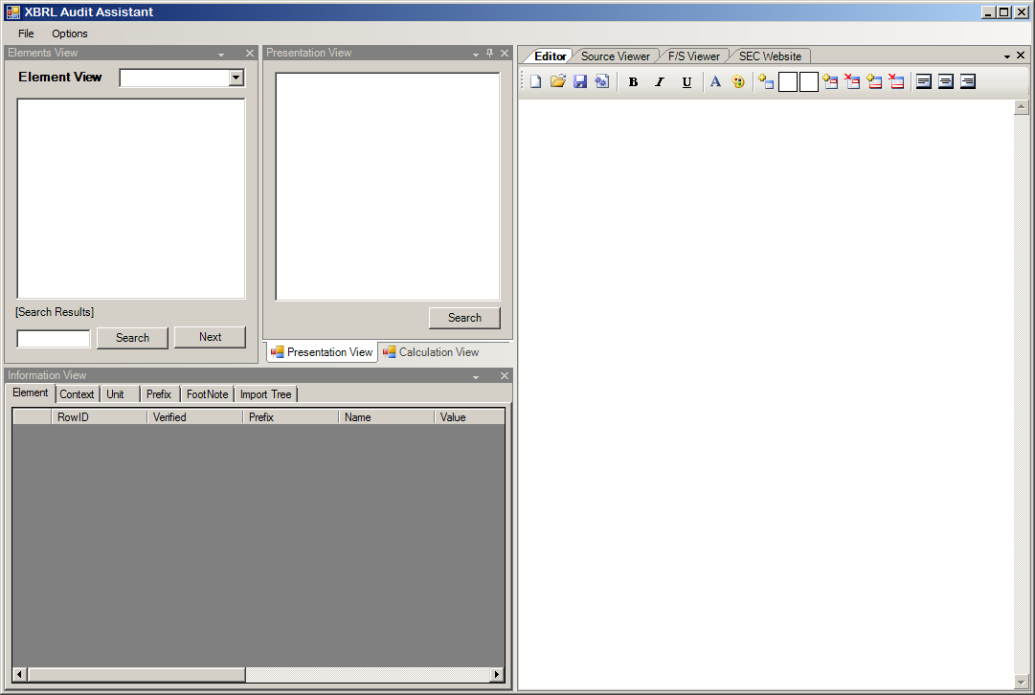
AN XBRL RENDERING TOOL:
XBRL AUDIT ASSISTANT
  Graphically represent XBRL elements to discriminate between those from official XBRL taxonomies and those from companies’ own extension taxonomies.
  Help auditors understand taxonomies used to create the instance document and the sources of the XBRL elements.
  Render XBRL instance documents to enable visual review and detailed checking of XBRL instance documents to original financial statements.
  Help auditors assess whether the data elements in the instance document reflect the same information as the corresponding financial facts in the official financial statements.
  Graphically represent a systematic structure of the XBRL instance document such as logical ordering of contexts, segments, and elements.
  Help auditors understand reporting period, units, the elements used in the instance document, etc.
  Generate XSLT stylesheets that enable auditors to render the XBRL instance document.
  The generated XSLT stylesheets can be used for other instance documents, if the documents were generated using the same taxonomies (e.g., for other quarters).

Slide 12
XBRL AUDIT CASE:
CASE SCENARIO
  Mark & Sons Future Technology Co. (hereafter, MSFT) is a $40 billion public company
  that provides high-technology products and services.
  The CFO of MSFT, Gerry Thompson, believes that current XBRL practices fall short of addressing the information quality issues that arise from the use of XBRL for business and financial reporting.
  Currently, XBRL does not require independent assurance. However, to enhance users’ confidence and widespread adoption of XBRL, assurance on the XBRL-Related Documents will be needed to reduce users’ uncertainties about the accuracy, completeness, and consistency of the XBRL-tagged information.
  Hence, he wants the recent XBRL filing of MSFT (2008-10-23) to be audited to assure its quality.
  After completing his master’s degree in accounting at the University of Waterloo, Mike Cullen was hired as an auditor by Waterloo & Co., an accounting firm.
  He has worked as an auditor for five years.
  Mike has been requested to manage an assurance engagement on the XBRL-Related Documents of MSFT.

Slide 13
XBRL AUDIT CASE:
ASSURANCE ENGAGEMENT PROCEDURES
  Client/engagement acceptance
  Audit Planning
  Testing and Collecting Evidence
  Internal Control (Task a-1)
  Compliance (Task b-1 to Task b-2)
  Suitability (Task c-1 to Task c-3)
  Accuracy (Task d-1 to Task d-3)
  Completeness (Task e-1)
  Occurrence (Task f-1)
  Consistency (Task g-1 and Task g-2)
  Evaluation and Reporting

Slide 14
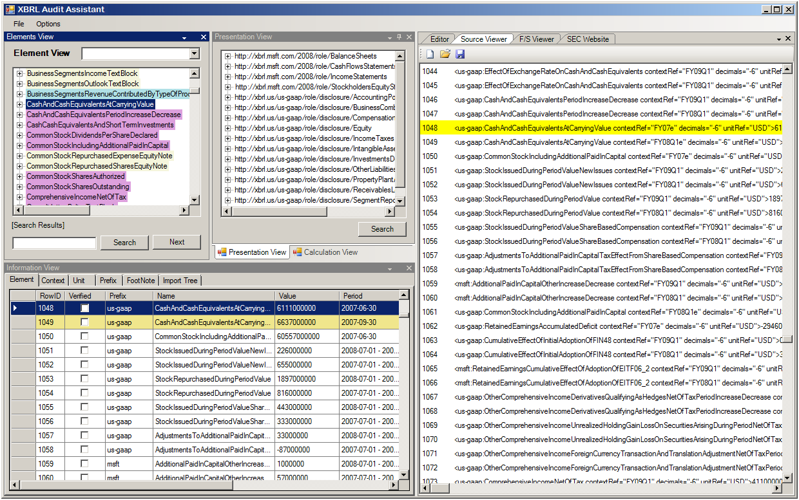
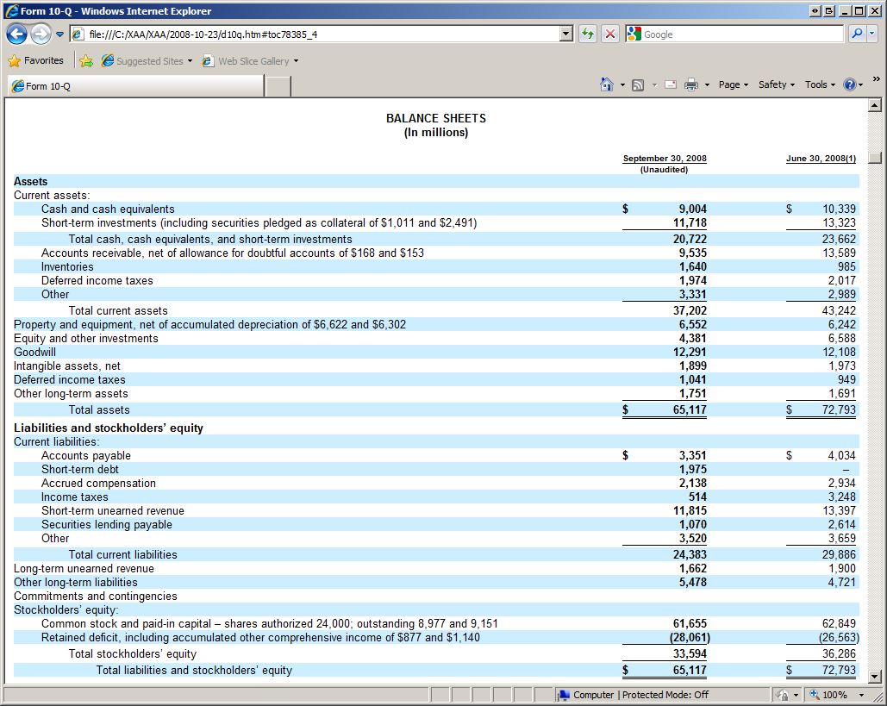
XBRL AUDIT CASE:
AN EXAMPLE: ACCURACY (Task d-2)
  Objective:
  The XBRL-Related Documents accurately reflect, in all material respects, all business facts presented
  in the official filing.

Slide 15
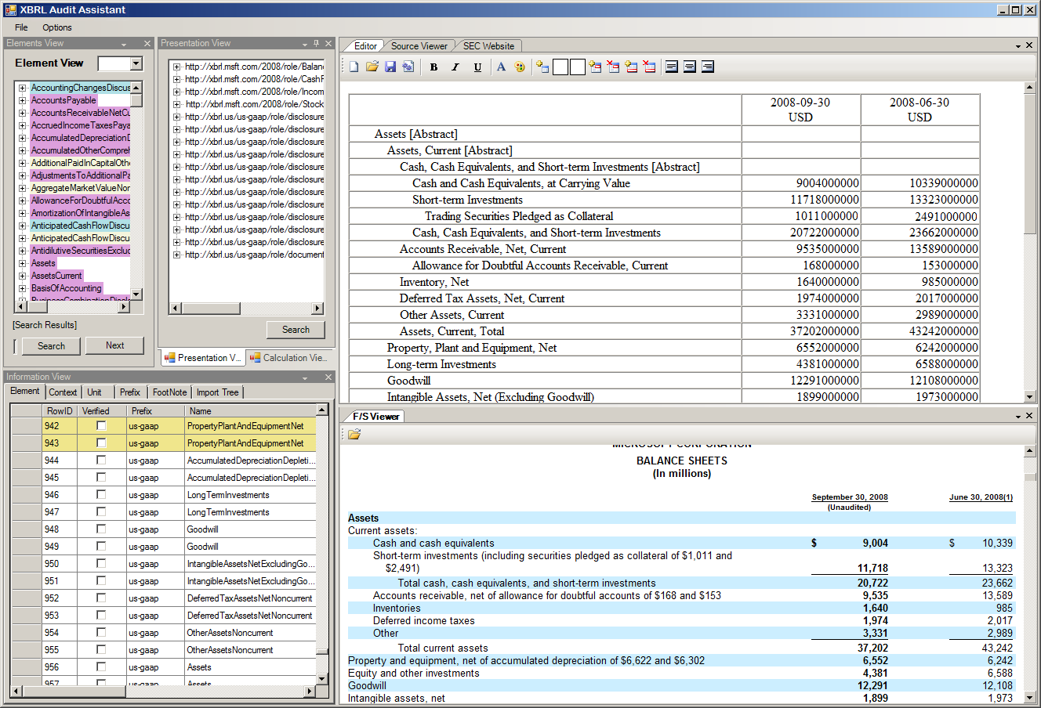
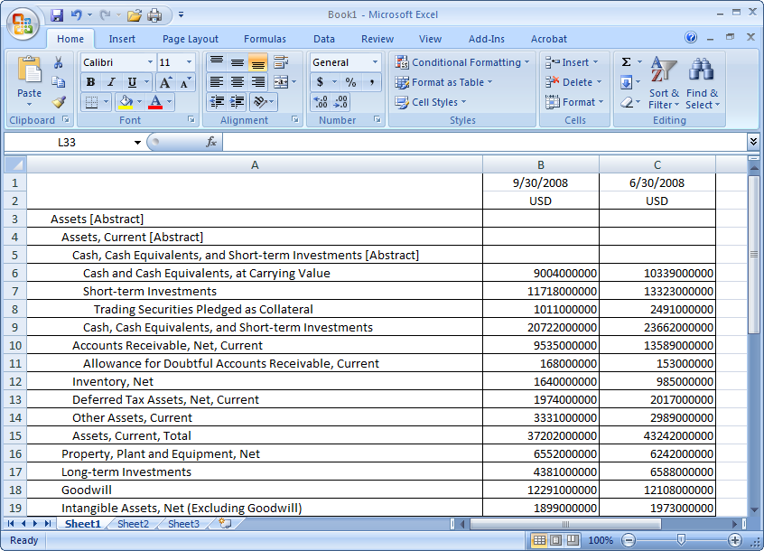
XBRL AUDIT CASE:
AN EXAMPLE: ACCURACY (Task d-2)
  Objective:
  The XBRL-Related Documents accurately reflect, in all material respects, all business facts presented
  in the official filing.
  Audit tasks:
  Compare the rendered XBRL-Related Documents to the corresponding information in the official filing.
  Verify that the data elements in the corresponding official filing have not been changed, deleted, or summarized in the XBRL-Related Documents.

Slide 16
PRELIMINARY EVALUATION
WORKSHOP AND PARTICIPANTS
  Workshop
  To assess the reasonableness of audit objectives as well as the usefulness of the XBRL Audit Assistant
  Questionnaire
  Developed to probe participants’ opinions regarding assurance on XBRL-Related Documents.
  Consisted of four sections
    To gather demographic information
    To capture the participants’ XBRL knowledge as well as their previous experiences with XBRL
    To measure the opinion about the audit objectives and audit tasks.
    To obtain the participants’ opinion about the computer assisted techniques (i.e., XBRL Audit Assistant) demonstrated in the workshop with respect to its potential to assist auditors in achieving the specified audit objectives effectively and efficiently.
  Participants
  A total of 19 audit professionals participated in the workshop.
  The majority of the participants (89.5%) were male.
  On average, the participants had approximately 19 years of work experience and were employed in various industries.
  The majority of the participants were working in IT-related areas (e.g., Information Systems Audit and Information Systems Security)
  About 46% of the participants majored in Information systems, and about 32% had an accounting major.

Slide 17
PRELIMINARY EVALUATION RESULTS
  Prior experiences
  Only one participant did not have previous experience with computer-assisted auditing.
  15 participants (approximately 79%) had previous experience with XBRL.
  Only four participants (21.1%) had prepared an XBRL document.
  Knowledge
  Most of the participants believed that they did not have the necessary knowledge with respect to XBRL.
  The respondents believed that they did not have current knowledge about how to achieve audit objectives in connection with XBRL documents.
  Most participants did not have confidence in their current knowledge about how to complete the 21 XBRL-related audit tasks.
  Usefulness of the computer assisted techniques
  The participants believed that a CAAT (i.e., XBRL Audit Assistant) is needed for most of the audit tasks identified (more than 50% of the participants said ‘Yes.’) except for audit task No. 1 (33%).
  (No. 1 : The auditor should evaluate whether any company extensions of the taxonomy are consistent with applicable legislative or regulatory requirements and XBRL specifications.)
  The participants considered that a CAAT would be the most effective and efficient for 20 audit tasks (more than 70% of the participants said ‘Yes’ for effectiveness and efficiency) except for audit task No. 1 (44% for effectiveness and efficiency).

Slide 18
CONCLUDING REMARKS
  Summary
  Discussed assurance issues regarding the XBRL-Related Documents.
  Identified several key audit objectives and related audit tasks
  Introduced an XBRL auditing tool that we developed (i.e., XBRL Audit Assistant).
  Discussed how the tool could be used to address those audit objectives for a company.
  Conducted a workshop to assess the reasonableness of audit objectives as well as the usefulness of the XBRL Audit Assistant.
  Next step
  The tool is still under development.
  Based on participants’ reactions to the tool demonstrated in the workshop, will be to add additional functions such as a mapping tool and an assurance report generator.
Notes:
Knowledge of Company’s Financial Statement Creation Process and the Process Used to Create XBRL-Related Documents (28.68 on a scale of 100), Knowledge of XBRL Taxonomies and Specifications (18.68), Knowledge of Applicable Regulations (14.74), Knowledge of Evaluating Extension Taxonomies (12.63), and Knowledge of Regulatory Requirements in terms of Context and Formats (9.74).
Internal Control (47.21 on a scale of 100), Compliance (30.00), Suitability (30.00), Accuracy (34.32), Completeness (28.89), Existence (30.00), and Consistency (34.84).
The highest audit task was the audit task No. 13 (48.42 on a scale of 100) whereas the lowest audit task was the audit task No. 4 (16.05).

Slide 19
QUESTIONS & SUGGESTIONS

