Slide 1

19th XBRL International Conference
“Reducing regulatory burden with XBRL: a catalyst for better reporting”
June 22-25, 2009
Paris, France
Case Studies in XBRL Solutions
Formula developments for Multiple Instance processing
Herman Fischer, UBMatrix and Mark V Systems

Slide 2
Topics
Use of formulas for validation
Multi-instance
  Use for multiple instances
  Use for chaining
  Use for modularity
Other validation topics

Slide 3
Use of formulas for validation
Validations usually needed for
  Completeness
  Correctness
  Consistency
  Accuracy
XBRL validation ensures some of above
Full validation was in applications
Now formulas perform validation

Slide 4
Example view of SEC validation
Instance Validation
Taxonomy Validation
None yet. Examples might include:
  Balance Sheets must balance
  Ending balance = beginning + changes
None yet. Examples might include:
  Extension taxonomy must reference standard formula linkbase
DEI elements must be reported
CIK number must be used correctly
Dimensions only used within segments
Companies shall provide absolute paths for references to base taxonomies and relative paths for extension taxonomies.
Naming standards followed
Tuples not allowed
Extensions cannot reuse base element names
Naming standards must be followed
Calculations must trace correctly
Duplicate facts not allowed
XML Valid
XBRL Valid
XML Valid
XBRL Valid

Slide 5
Historical Perspectives
2002 - FDIC contract motivates solutions
“ - Rule base Requirements IWD
2003 - XPath syntax chosen
“ - Functions spec drafted.
2004 - Formula drafts, some implementations
2006 - Alternative approach with XQuery
2007 Jan- Issued Formula PWD
Feb, Mar - Survey of users, feedback
June, Dec, Feb – PWD updates after PWD feedbacks
Mar 2008 – Candidate Release (spec) & Test Suite
May 2008 – Implementations of processors
Sept 2008 – Production formulas (COREP, FINREP)
Dec 2008 – CR-2 (dimensions and other fixes)
Jun 2009– Recommendation
FWG
follows
XBRL
process

Slide 6
Formulas & Assertions
Assertion
  Existence check for source item
  Value check based on source items
  Consistency check computed item to source item
Formula
  Results in an fact item
    For an output instance document
    For consistency checking of corresponding input

Slide 7
Process flow of formula linkbase
Formula LB*
Assertions
existence
value
consistency
Input inst.
DTS
contexts
units
fact items
Formula
Processor
Output inst.
computed
fact items
*Formula LB is part of DTS

Slide 8
Input instance processing
Instance provides producer’s taxonomy, facts, and producer’s formulas
Consumer may attach their formulas
Formula processor evaluates variables, preconditions, assertions and formulas
Report of assertion test results
Output instance of result fact items

Slide 9
Formula linkbase contents
Formula LB*
arc
formula
assertion
Parameter
(select expr.)
variable
filter
custom
function
precondition
label
ref.
Input inst.
DTS
contexts
units
fact items
Assertions
consistency
existence
value
Formula
Processor
Output inst.
computed
fact items
*Formula LB is part of DTS

Slide 10
Four processing models
Existence Assertion
Count evaluations variables & preconditions Apply a test to the count
Value Assertion
Evaluate variables Apply testing expression
Formula
Evaluate variables Produce new fact item of Value expression Aspects rules
Consistency Assertion
Evaluate formula Compare to source fact v-equals or value radius

Slide 11
Examples of each model
Existence Assertion
Total assets is reported Correct entity is reported No fact after cut off date
Value Assertion
Ratio > minimum Capital adequacy ratio > 8% Interest cover ratio > 2.5% Cash balance is positive
Formula
Assets = liabilities + equity Ending balance = starting balance + flows
Consistency Assertion
Reported item matches computed item Assets Ending balance

Slide 12
Formula Status
Status = “Recommendation”
Four “known” implementations
  Fujitsu & UBmatrix conformant, in production use
  CompSci Resources & New Lido projects
Major stake holders
  BdE, BdF, BoJ, SEC deployed
  FDIC has early-IWD formulas

Slide 13
Specifications are Extendable
Capabilities per specification
  Producing fact items (output instance document)
    Single input instance, single output instance
  Assertions for
    Consistency (produced fact vs. reported fact)
    Existence
    Value
Extension areas

Slide 14
Extensions
Prototyped
Custom functions in XPath
Message composition
Multi-instance processing
Formula chaining
Tuple generation
Linkbase & footnotes processing
Interesting ideas
Very Large Instances processing

Slide 15
Why need multi-instance?
Multiple companies reporting
  Different company extension taxonomies
Multiple periods reporting
  Different taxonomy year, linkbases changed
Multiple types of reports
  Different taxonomies for each

Slide 16
Why need multi-instance /multi-taxonomy Formulae?
Cross Industries Reporting Analysis
  Different company extension taxonomies
Cross Border Reporting Analysis
  Different country taxonomies:
  - Public Company F.S.: EDINET (Japan) and US Gaap (USA)
  - Private Company F.S.: Infogreffe (Fr), NBB (Belgium), Infocamere (It)…
Cross Financial & Prudential Reporting Analysis
  Different taxonomies e.g. FINREP & COREP
Cross Multi-Data Sources Analysis
  Different taxonomies for each Data Sources:
  - Statistics Bureau & Corporate Registry
  - Stock Exchange & Statistics Bureau

Slide 17
Merging instances, first idea
Usually multiple quarters or years
Different taxonomies per year
  Namespaces change
  Linkbases change
Linkbases change per year
  Subtrees in vicinity of reported concepts
May not be mergable

Slide 18
Merging formula input instances
Formula LB
Current Yr
Assertions
existence
value
consistency
Merged inst.
DTS
contexts
units
fact items
Prior 1 Yr
Formula
Processor
Merge
Output inst.
computed
fact items
Prior 2 Yr
Facts merged
conceptRefs ‘hacked’
Extend DTS to union of
input DTSes
namespaces ‘hacked’

Slide 19
Handling multiple instances
Issues to merge instances
  Taxonomies differ?
    Concepts change with changes in law, practice
    Dimensions change
    Tree relationship in presentation, definition change
    Namespaces change
  ContextRef’s will be changed in merging
    E.g., current-yr-consol, prior-yr-consol
    May be constraints on altering contextRef’s

Slide 20
Multi-instance formulas
Each instance loaded with its taxonomy
Formula terms refer to nodes, which know their enclosing document
Schemas and linkbases kept separate

Slide 21
Multi-instance formula inputs
Current Yr
current DTS
Formula LB
Assertions
existence
value
consistency
Prior 1 Yr
prior DTS
Formula
Processor
Output inst.
computed
fact items
Prior 2 Yr
prior 2 DTS
each fact variable
knows source DTS
instances loaded
with their DTSes

Slide 22
Multiple instances
Multiple entity instances
  Same period but different entities
  Different company extension taxonomies
Multiple period instances
  Taxonomies change
  Namespaces change
  Linkbases and dimension aggregations change
Multiple types of reports
  Different taxonomies for each

Slide 23
Muti-instance solves chaining
A simple approach to chaining
Common solution to multi-instance and chaining
Multi-instances can be ‘scratch-pads’ during computation
Applies to very large instance solution

Slide 24
Multi-instances for chaining
Formula LB
arc
formula
assertion
Parameter
(select expr.)
variable
filter
custom
function
Temp. inst.
Temp. inst.
Temp. inst.
Formula
Processor
Input inst.
Input inst.
Assertions
Input inst.
Output inst.
*Formula LB is pat of DTS

Slide 25
Planned multi-instance solution
Instances are represented by a resource
instance-variable arc to variable
  If present, specifies non-default source instance
formula-instance arc from formula
  If present specifies the instance to receive fact
Instance resources are files or temporary

Slide 26
Instance resources
Could be loaded by processor
  E.g., java code in a server loads primary instance and some prior-period or other-company instances
  Or user of GUI adds ‘additional’ instances, such as loading prior-period or other-company instances
Default implied source and result instances
Can be temporary in memory only
  Used for chaining and modularization

Slide 27
Aspect sources, implicit filtering
Formula aspects come from its variables
Variables from different instances contribute aspects
  Aspects independent of the instances they come from
  Aspect “covering” is by-aspect, not by-instance

Slide 28
A=B+C; C=D+E use case
(Multi-instance chaining)
Formula 1 (A=B+C)
  Result is A, factVariables B & C
  factVariable B is from source instance (default)
  factVariable C is from result instance (has an arc)
Formula 2 (C=D+E)
  Result is C, factVariables D & E
  factVariables D & E are from the source instance

Slide 29
A=B+C; C=D+E (Example 0026 v-01)
Multi-instance chaining

Slide 30
COREP Use case 18: Weighted average of member children
Weighted average of its dimensional children
by another primary item

Slide 31
Current single-formula solution
Excel formulas:
Make PD controlling fact, get PD and EV of dimensional children
General variable for PDxEV member matching

Slide 32
Single formula (Example 0017 v-01)
difficult
to explain

Slide 33
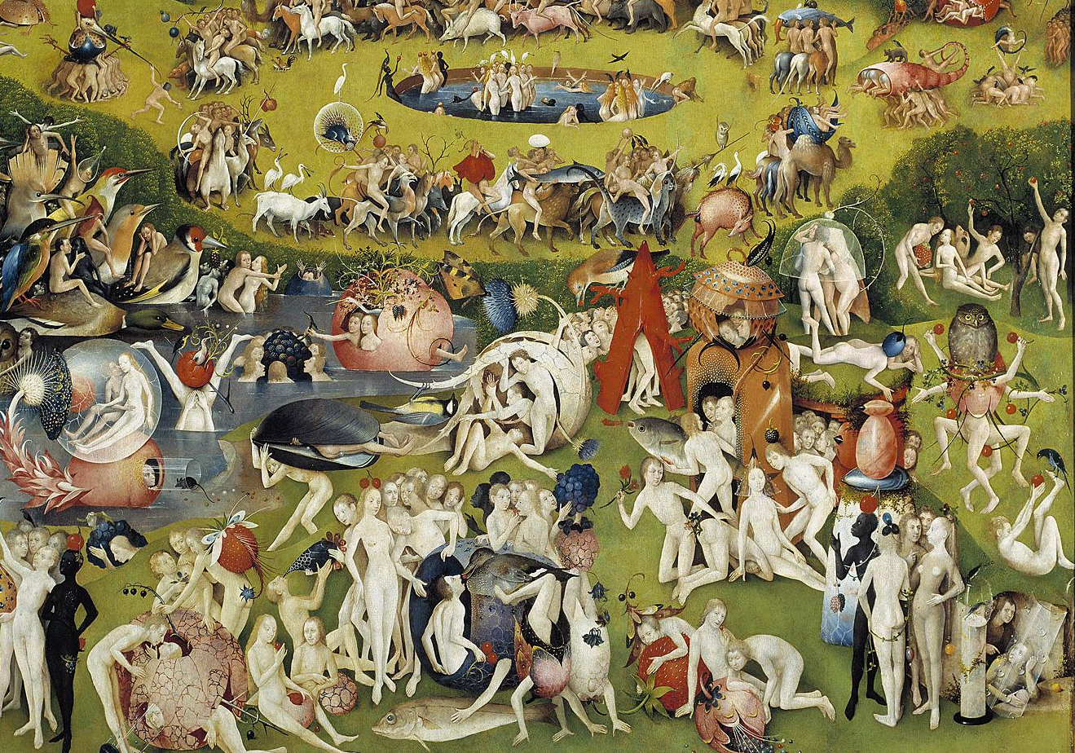
Simplifying Formulas

Slide 34
Exposure value formula
Each PD x EV produced by one formula
  Result factItem PDxEV is the product for each dimension value
Second formula binds PDxEV’s of dim-children to sequence and EV’s of dim-children to second sequence, value assertion checks result

Slide 35
New idea: multiple result instances
The PDxEV result fact items aren’t needed for a real result instance
Only a value assertion is really needed
A temporary-results instance in-memory
  Like a scratch-pad
Also a temporary facts DTS would be needed (to define the PDxEV result fact item)

Slide 36
Chained formulas (0026 v-20)

Slide 37
Implementation issues
Multi-instance term binding
  Variables can be bound to different source instances
  (This already exists in xfi:inst() based solution.)
  Each term in XPath ‘knows’ its instance/DTS (in the internal model or DOM of implementation)
Function binding
  A function with item results must keep the instance/DTS of the function result (based on the input terms)

Slide 38
Other extensions in use
Custom functions
  Via function registry (e.g., Java implemented)
  Via Xpath (e.g., in distributable linkbase)
Assertion messages

Slide 39
Questions
Herm Fischer
herman.fischer@ubmatrix.com
fischer@markv.com
+1-818-995-7671
+1-818-404-4708
THANK YOU!

